Slide 1
Putting Investors First
CFA Society, Orlando, Florida
May 3, 2016
Knut A. Rostad, President
Institute for the Fiduciary Standard
www.thefiduciaryinstitute.org

Slide 2
Thank you, CFA Orlando!
Institute: nonprofit formed in 2011 to advance fiduciary principles
CFA Institute and Institute for the Fiduciary Standard
John C. Bogle Legacy Forum (2012), Campaigns on Importance
of Investor Trust, CFA Charterholders on Best Practices Board

Slide 3
The State of Fiduciary Duties: A Call for Activism
A Look back to 1940: Why fiduciary duties exist in securities law
1995—2015: Key events in the markets and at the SEC
The battle over two visions and two views of “advice” and “sales”
2016: DOL Conflict of Interest Rule
2016: ‘Engaging Investors, First’
A new conversation with investors about what really good advisors do and how CFA Orlando can lead the nation

Slide 4
Fiduciary Duties in Advisers Act of 1940 and Common Law
Fiduciary law versus contract law
Fiduciary concept in law, medicine, and finance exists to build trust and confidence in experts of socially important services
Inherent information asymmetry divides the layperson and expert
Advisers Act of 1940 crafted in the wake of the ‘29 stock market crash, to separate salespeople from advisors in finance

Slide 5
Advisers Act of 1940 as articulated by the Supreme Court in SEC v. Capital Gains Research Bureau
“It requires but little appreciation… of what happened in this country during the 1920’s and 1930’s to realize how essential it is that the highest ethical standards prevail’ in every facet of the securities industry…”
375 U. S. 180 (1963)

Slide 6
‘Investment Advisers could not perform their basic function … unless all conflicts of interest .. were removed’
”The report reflects the attitude – shared by investment advisers and the Commission – that investment advisers could not ‘completely perform their basic function – furnishing to clients on a personal basis competent, unbiased, and continuous advice regarding the sound management of their investments – unless all conflicts of interest between the investment counsel were removed..”
375 U. S. 180 (1963)
6

Slide 7
‘An investment adviser should continuously occupy an impartial and disinterested position …’
”The report incorporated the Code of Ethics and Standards of Practice of one of the leading investment counsel associations… ‘(an investment adviser) should continuously occupy an impartial and disinterested position, as free as humanly possible from the subtle influence of prejudice…”
375 U.S. 180 (1963)
7

Slide 8
‘Two principles … not engage in any other activity, such as security selling and brokerage … remuneration “solely” fees ’
”The president of the ICA of America … testified: ‘two fundamental principles … were, first, that they would limit their efforts and activities to the study of investment problems from the investors standpoint, not engaging in any other activity, such as security selling and brokerage, which might directly or indirectly bias their investment judgment; and, second, that their remuneration for this work would consist solely of definite, professional fees, fully disclosed in advance…”
375 U. S. 180 (1963)

Slide 9
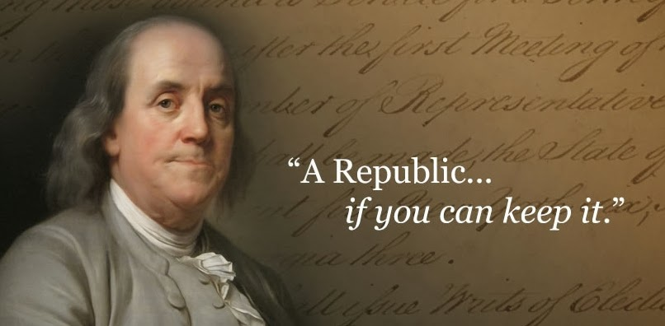

Slide 10
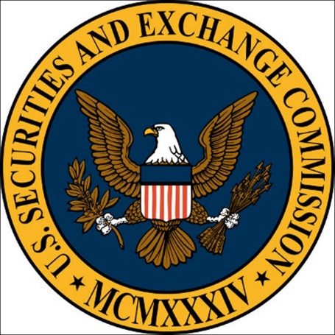
The Markets and the SEC The Backdrop: 1970’s, 1995-2015
BT (Before Tully) Deregulation of commissions and Vanguard incorporated, May 1 1975, First Schwab office September 1975
SEC Tully Report (1995) on brokerage conflicts
Brokerage firms’ promoting “trust,” “client’s interest” “personal” advice (1995-2015)
FPA v. SEC (2005 -- 2007)
Financial Crisis (2008), Dodd Frank (2010), Finance high profile wrongdoings (2008-15)
SEC on uniform standard (2013); opinions on conflicts, disclosure (2013-15)
10

Slide 11
The Markets and the SEC The Backdrop: 1970’s, 1995-2015
By 2015, SEC affirms that serving clients’ “best interest” regarding conflicts does not mean avoiding conflicts. It does not mean disclosing AND mitigating conflicts. It does not mean disclosing/mitigating conflicts and demonstrating the recommendation serves a client’s best interest. It does mean disclosing conflicts (sometimes with consent).
11

Slide 12
“Houston, we have a problem.”

Slide 13
Battle Over Meaning of Advice
View in History, Law, Logic & Advisers Act
Advice and sales are inherently different and are understood to be different by consumers
AKA “Conflicts are Harmful View”
Advice – Expert advisor who is objective, competent, credible, and is paid to represent me
Sales – Expert sales person paid by company to distribute product, give product info, provide service; not service
Notes:
; not advice

Slide 14
Battle Over Meaning of Advice
Industry View: ‘We are all salespersons, now’*
Antithetical to history, law, logic and Advisers Act
AKA “Conflicts are OK View”: Conflicts are everywhere,
part of life, cannot be avoided; thus, “acceptable”
Widely held by certain federal securities regulators and financial service industry
*With apologies to Milton Friedman, whose quote “We are all Keynesians now” was popularized by Richard Nixon

Slide 15
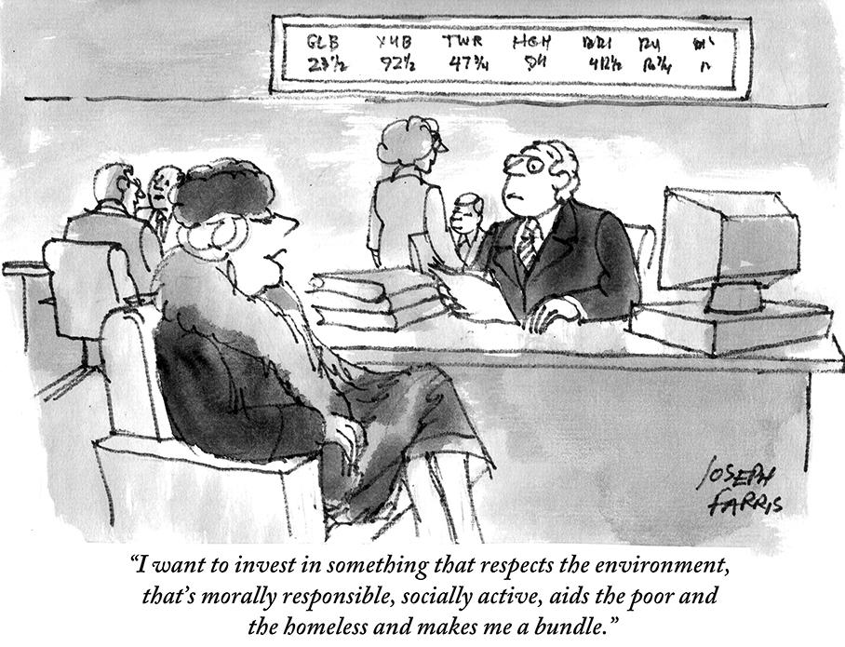
Battle Over Meaning of Advice
Investors don’t know there’s a battle; they know advice is different from sales
Except in finance where many say they “advise” when they sell
As CFA Managing Director, Kurt Schacht, wrote in 2015:
“If you are transparent that you are not acting solely for the benefit of the customer and that you are not their personal investment adviser, that’s fine. (But) … stop holding yourself out as someone’s personal financial adviser because you are not – you are a salesperson.”
15

Slide 16
2016: An Historic Moment?
Increased investor awareness of fiduciary versus sales standards from DOL Conflicts of Interest Rule
Growing millennial voice of skepticism
New technologies, products and delivery: ‘Robos’
CFA Institute campaign ‘Putting Investors First’
Institute for the Fiduciary Standard Best Practices for Financial Advisors and (to be announced May 24) Campaign for Investors
16

Slide 17
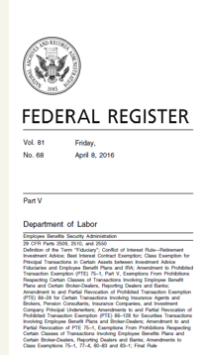
DOL Conflict of Interest Rule
1023-page rule aims to restore advice -- against the lobbying of the most influential industry in the country.
Rule kicks off a new era; a giant first step to reassert fiduciary ideals and to put fiduciary practices at the center of advice.
Rule raises questions that may require months/years to resolve. Meaning of “best interest” and “reasonable compensation?”
Advisors must fill vital role by leading and showing investors what “best interest” means.
17

Slide 18
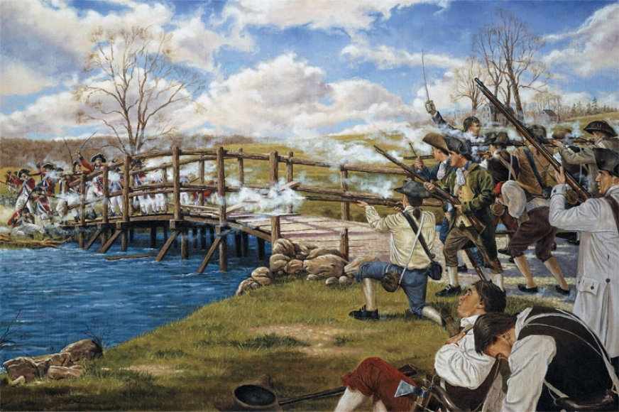
The Shot Heard ‘Round the World
241 years ago in Concord, Massachusetts, 1775
18

Slide 19
2016: A Time to Lead
One. Accept that investor skepticism is huge. It requires advisors do more and talk less. To show investors in deeds what the DOL Rule should mean in concrete and practical terms.
Two. “Engage with Investors First” to “Put Investors First”
Three. Build on CFA Integrity List and Statement of Investor Rights. Speak in plain language about what really good advisors do. Verify.
Four. Speak out in public about what investors should expect.
Five. CFA Orlando, lead the nation and all other CFA Societies in how you will “Put Orlando Investors First”
19

Slide 20
Do More. Raise the Bar. Lead.
Put in writing that your fiduciary status exists at all times
Put in writing what clients pay. In “total costs.” In fees paid and fees and expenses received by the firm
Put in writing your conflicts and how they are overcome/managed
Put in writing your investment policy process or statement
Stay away from proprietary products or principal trading
Bottom line: Do what’s reasonable. Put it in writing. Verify.
Adopt Best Practices for Financial Advisors

Slide 21
Do More. Speak Out. Lead
Speak out. Talk in plain English about what fiduciary advisors do. And what differentiates fiduciary deeds from product sales. And fiduciary deeds from bad practices too often seen in finance.
Lead. Think in large ways how CFA Orlando can advance “Putting Investors First” in 2016.
21

Slide 22
CFA Orlando: Make Orlando “Investors’ Best City in America”
Lead the country and the world in “Putting Investors First”
Urge adoption of asset manager code of conduct
Establish an Orlando Campaign for Investors that challenges all advisors to meet Best Practices.
Reach across the aisle. Bring fiduciary advisors together. Invite other advisor groups to join.
Launch “Orlando, Investors’ Best City in America” during ‘Fiduciary September’ 2016
22

Slide 23
Thank You
www.thefiduciaryinstitute.org
Knut A. Rostad, President
Institute for the Fiduciary Standard
CFA Society, Orlando, Florida
May 3, 2016

